Slide 1
Network Address Translator
Software Defined
by Denis Plotnikov
Design: http://www.tidyform.com/download/business-technology-circuit-board-design-presentation-widescreen.html

Slide 2
What is a Network Address Translator (NAT)?
Component of data networking equipment
Standard and integral equipment for Internet Service Provider (ISP) data networks
If high performance is needed – a specially designed device is used which costs a lot

Slide 3
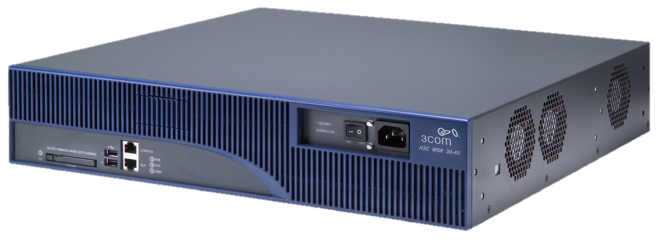
A typical high-performance NAT device looks like this

Slide 4
The problem
A high-performance NAT costs a lot:
Around $6000 per 10G packet per second
at minimum

Slide 5


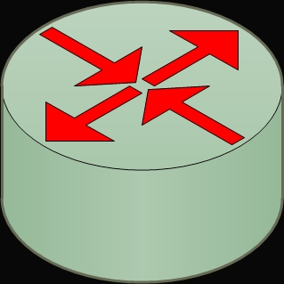
How can we make it cheaper?
+
=
A cheap regular server
Our software package
Software Defined NAT

Slide 6

Which will look like this
…and will cost
around $1800

Slide 7
Market Price Comparison
Our Software Defined NAT costs 50% less than a traditional NAT

Slide 8
Benefits of using a Software Defined NAT?
Costs 50% less than a traditional NAT, but has the same performance characteristics
Easily upgradable
Easily maintainable
More performance on upcoming processors

Slide 9
THANK YOU!

Slide 10
Traditional NAT prices

Slide 11
Software Defined NAT Target Characteristics
Throughput: 10G bits per sec
Packet processing rate: 10M packets per sec
Connection setup rate: 3M sessions per sec
Concurrent session support: 65.5M sessions

Slide 12
What makes our software work so fast?
High-performance software design principles
Specially designed for fast processing of packet data
Parallel computations
Intel© DPDK framework

Slide 13
Software Defined NAT cost estimation
Component name | Model | Price, $
Processor | Intel Core i5-4690 | 220
RAM Modules | SiliconPower SP016GXLYU16ANDA x2 | 320
Motherboard | SuperMicro X10SLL-S (Intel C222) | 200
Hard Disk | Intel DC S3610 | 275
Network Interface Card | Lenovo 10Gb X540-T2 | 600
System Unit | SuperMicro CSE-732D2-500B | 200
TOTAL: $1815

Slide 14
Development Team
Denis Plotnikov – a Skoltech student
under the supervision of two Intel© professionals:
Vadim Sukhomlinov – Strategic Business Development Manager
Areg Melik-Adamyan – PhD, GNU Toolchain Manager

